Slide 1
Special Considerations for the Veteran Population
Jeffrey McCarthy, PsyD
Program Manager CBOC Mental Health Services
VA Central Western Massachusetts Health Care System

Slide 2
Why We Are Here

Slide 3

First Responder Training
Notes:
Affected people may experience shock, anger, guilt, symptoms of depression/anxiety, and may even experience thoughts of suicide themselves.

Slide 4
War may be hell…but home ain’t exactly heaven, either. When a Soldier comes home from war, he finds it hard…
adapted from “A gentle reminder to keep your life in perspective. “
CPT Alison L. Crane, RN, MS
Mental Health Nurse Observer-Trainer
7302nd Medical Training Support Battalion

Slide 5
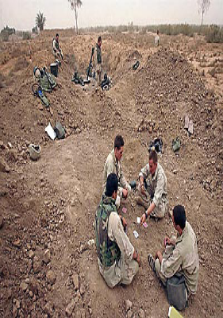
…to listen to his son whine about being bored.

Slide 6
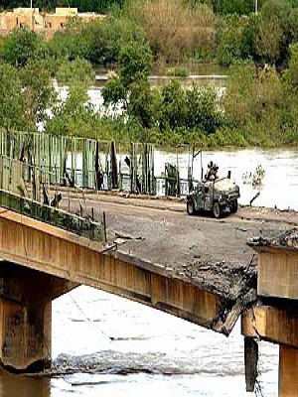
…to keep a straight face when people complain about potholes.

Slide 7
…to be tolerant of people who complain about the hassle of getting ready for work.

Slide 8
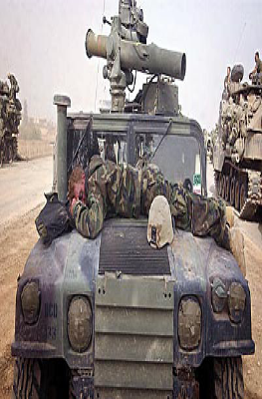
…to be understanding when a co-worker complains about a bad night’s sleep.

Slide 9

…to control his panic when his wife tells him he needs to drive slower.

Slide 10
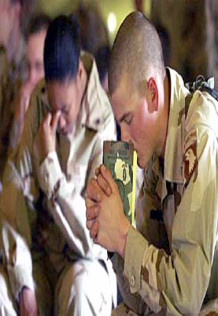
…to be silent when people pray to God for a new car.

Slide 11
…to be compassionate when a businessman expresses a fear of flying.

Slide 12
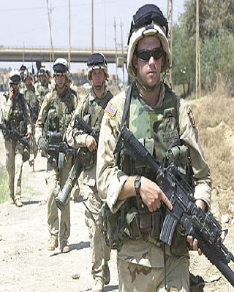
…to not laugh when anxious parents say they’re afraid to send their kids off to summer camp.

Slide 13
…to not ridicule someone who complains about hot weather.

Slide 14
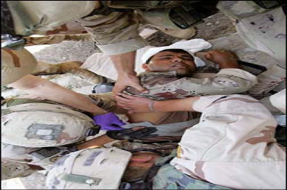
…to control his rage when a colleague gripes about his coffee being cold.

Slide 15
…to remain calm when his daughter complains about having to walk the dog.

Slide 16
…to be civil to people who complain about their jobs.

Slide 17
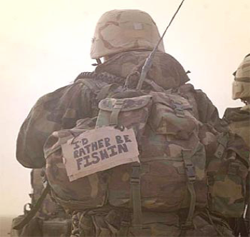
…to just walk away when someone says they only get two weeks of vacation a year.

Slide 18
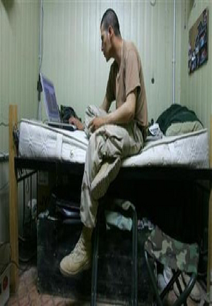
…to be happy for a friend’s new hot tub.

Slide 19
…to be forgiving when someone says how hard it is to have a new baby in the house.

Slide 20
What is a Veteran?

Slide 21
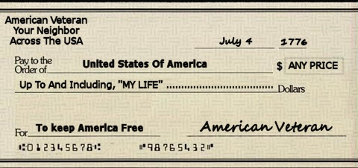
A Veteran is someone who, at one point in their life wrote a blank check made payable to the United States of America for an amount of up to and including their life.

Slide 22
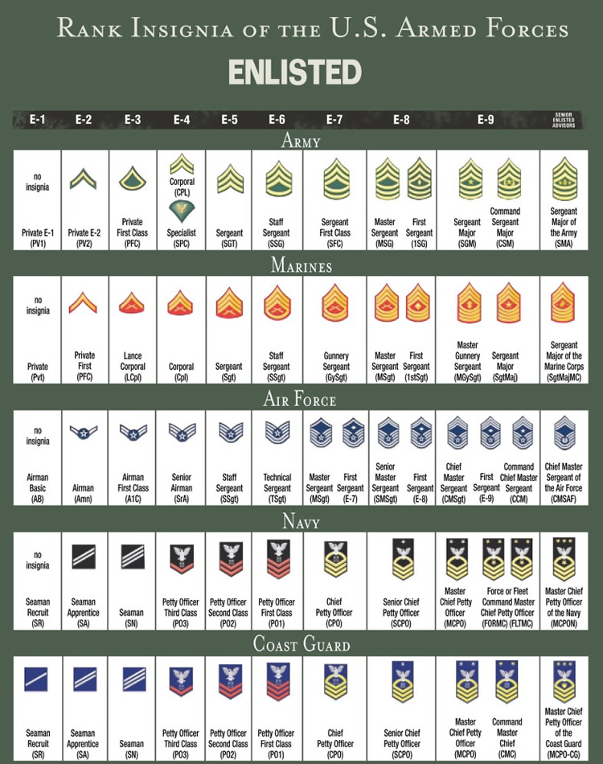

Slide 23
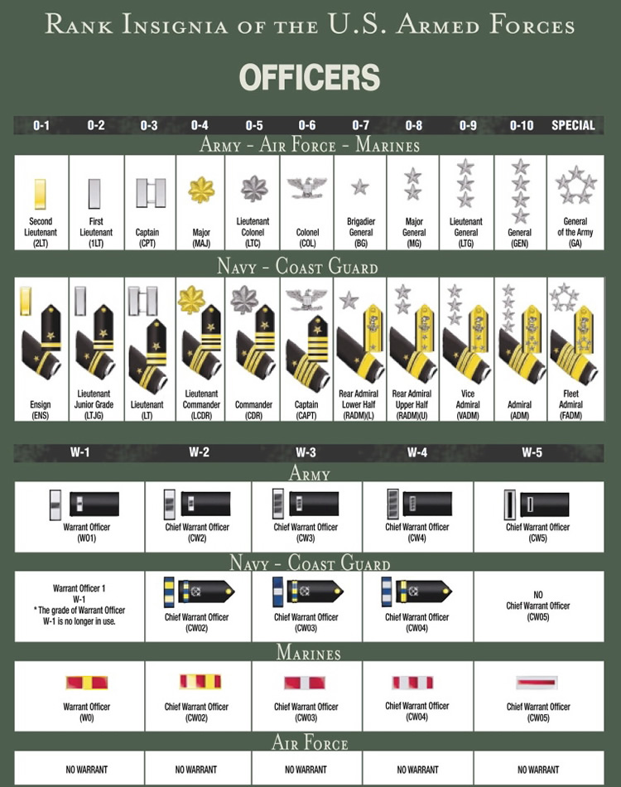

Slide 24
HISTORY OF RECENT CONFLICTS
World War II (1941-1945)
Korean War (1950-1953)
Vietnam (1961-1975)
Grenada (1983)
Panama (1989)
First Gulf War/Desert Storm (1990-91)
Somalia (1993)
Bosnia(1993-1995)
Kosovo (1998-1999)
Operation Enduring Freedom/OEF (2001-present)
Operation Iraqi Freedom (2003-2011)

Slide 25
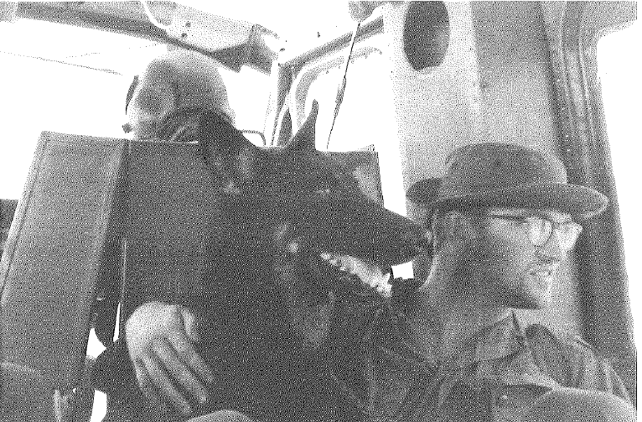
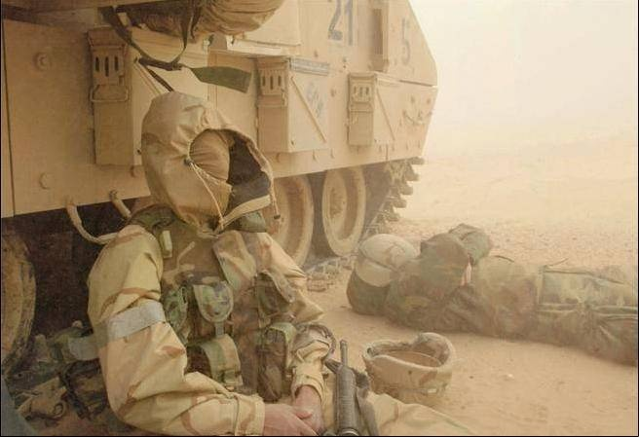
War Environment
Climate, Gear, Technology, Accessibility to treatment, Type of Warfare, Environmental Exposure …
Notes:
clinician
Different for every vet depending on conditions, etc.
May have trouble with sleep if they had no access to beds, cots, etc. Lack of sleep can increase irritability and viigliance. Also some may turn to substance use to manage.
Terraine,
Weather
Overall conditions.
Some access to supplies, others none, some urban (BAGHDADA) other mts of Afghanistan or remote villiages

Slide 26

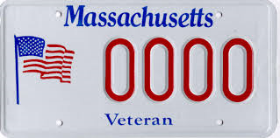

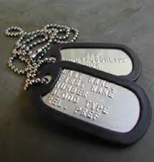

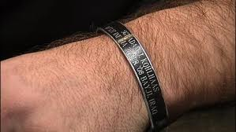


How to Spot a Veteran

Slide 27
OEF/OIF Facts
2.7 million military personnel have been deployed since the War in Afghanistan began in late 2001.
89 % are men, 11% are women
43% screened positive for PTSD, MDD, or Alcohol Use Disorder
2000 - 2017: > 379,000 suffer from some form of closed-head injury

Slide 28
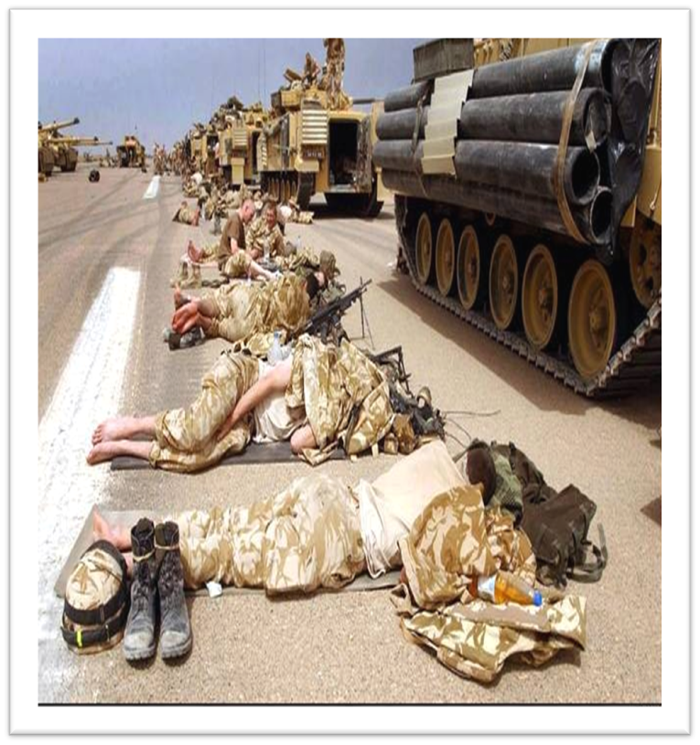

Readjustment
Combat Zone
Home

Slide 29
Military vs. Civilian life
Predictability vs. variation
Following orders vs. making decisions
Expectations of unit vs. expectations of family
Mission orientation vs. every person for themselves
Shared experience/camaraderie vs. no one understands

Slide 30
Adjustment
The stresses and effects of combat on behavioral health are fairly well documented. PTSD, Traumatic Brain Injury, and general readjustment issues sometimes manifest themselves in Veterans as crisis encounters with law enforcement or first responders.
The community’s response to this crisis can have a major impact on the Veteran, the Veteran’s family, and the community itself.

Slide 31
PTSD-Clinical Criteria
Trauma-experiencing or witnessing life threatening event
Symptoms lasting more than a few months and interfering in life:
-Re-experiencing
-Avoidance
-Hypervigilance
-Disconnection

Slide 32
Symptoms of PTSD
Re-experiencing the event
  -nightmares
  -flashbacks
Avoidance
  -crowds
  -people, places, things that remind you of the event
  -thinking about or talking about event
Negative changes in beliefs and feelings
  -difficulty connecting with others
  -loss of interest in enjoyable activities
  -difficulty recalling important parts of the traumatic event
  -feelings of impending doom
Hyperarousal
  -sleep challenges
  -trouble concentrating
  -easily startled
  -hypervigilance/over interpret things as threats

Slide 33
PTSD Veteran Stats
Operations Iraqi Freedom (OIF) and Enduring Freedom (OEF): 11-20% who served in OIF or OEF have PTSD in a given year.
Gulf War (Desert Storm): 12% have PTSD in a given year.
Vietnam War: 15% (late 1980s study, estimated more likely to be 30%)

Slide 34

Sounds of Trauma by David Lynch Foundation
https://www.youtube.com/watch?v=bgpRw92d1MA
Notes:
Play audio first

Slide 35
Difficulties with diagnoses and/or treatment
PTSD
Depression
Mild TBI

Slide 36
Further contributing factors
PTSD
Depression
Mild TBI
Chronic Pain
Substance Abuse
Auditory Problems/
Visual Deficits
Residual Physical
Injuries
Notes:
36

Slide 37
Further contributing factors
PTSD
Depression
Mild TBI
Financial Strains
Chronic Pain
Substance Abuse
Family Pressures
Lack of Resources
Work Stressors
Auditory Problems/
Visual Deficits
Residual Physical
Injuries
Notes:
37

Slide 38
Behaviors We May See
Risky behaviors to get the adrenaline rush
Speeding/Erratic driving/road rage/avoidance driving/non-defensive driving
Panic while in traffic
Violent Behavior (Rage)/Domestic Violence/Child abuse
Addictions (work, drugs, alcohol, food, adrenaline, sexual behavior)
  Combat exposure increases the likelihood of substance use
Withdrawal, isolation, intolerance of others
Complain of headaches, chronic pain, forgetfulness
Emotional dysregulation/Impulsive

Slide 39
Domestic Violence
Higher rate of domestic violence in military compared to civilian counterpart
There is generally a spike in DV upon return from deployment
DV increases with subsequent deployments and with longer deployments
DV increased by 33% from 2006-2011 in Army families
June 2018: VA commits $17 million to expand IPV assistance program

Slide 40
Combat Exposure and Substance Use
Alcohol abuse doubles following combat deployment (Jacobson et al 2008)
Greater combat exposure is associated with greater substance abuse
Reserve & Guard personnel had higher rate of new onset alcohol abuse post deployment than active-duty personnel

Slide 41
Warning Signs of Suicide
Hopelessness
Rage, anger, seeking revenge
Acting recklessly or engaging in risky activities, seemingly without thinking
Feeling trapped—like there’s no way out
Increasing alcohol or drug abuse
Withdrawing from friends, family, and society
Anxiety, agitation, inability to sleep, or sleeping all the time
Dramatic changes in mood
Perceiving no reason for living, no sense of purpose in life

Slide 42
Facts about Veterans and Suicide
Suicide was the second leading cause of death for Veterans ages 18-45
Veterans are more likely than the general population to use firearms as a means for suicide
On average, 16.8 Veterans die by suicide every day in the US. 6.7 of these Veterans are engaged in VHA care, 10.1 are not.
6,146 Veterans died by suicide in 2020, which is 343 fewer than in 2019

Slide 43
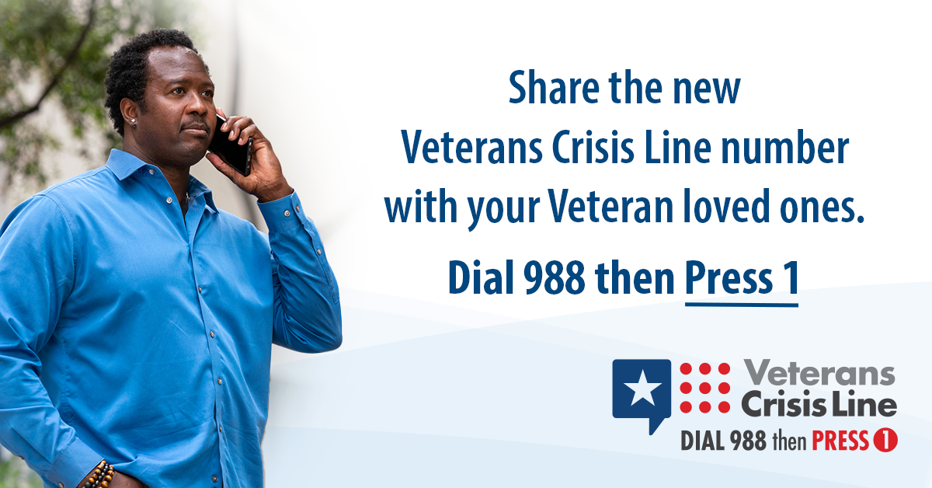
Veterans Crisis Line: Call, Chat, or Text

Slide 44
What can we do?

Slide 45
De-escalation
Techniques to employ
When interacting with those who may be experiencing psychiatric symptoms and/or are conditioned to be impulsive, reactive, ready to defend, consider:
  Non verbal awareness (eg. body posture)
  Verbal cues (eg. tone of voice)
  Personal Space
  Environment (lower lights, radio)
Reduce the intensity of the situation
Goal is not only to maximize de-escalation, but also to PREVENT escalation or re-escalation
Requires ongoing re-assessment of situation
Speed up or slow down your response based on the situation

Slide 46
Techniques to employ (cont.)
Other considerations:
  Clarification (“good dentist technique”)
  Simple 1-step instructions
  Stay calm/supportive
  Grounding …Get them in the here and now…(Where were you heading? Do you know what street you are on now?)
  Breathing
  Walk together/Get to sit down
  Avoid threats, intimidation, judgement
  Active listening / Open-ended questioning

Slide 47
Actions to consider when responding to Veteran crisis
Look for clues that your subject is a veteran
Ask “Have you served in the US military?”
  Respect veteran status
  Express appreciation for their service
  Ask about military (“I see you have a veteran plate…thanks for your service! what branch were you in?”; IF you are a veteran and feel comfortable—disclose branch, etc).

Slide 48
Actions to consider when responding to Veteran crisis
Take extra safety precautions
Establish a distance between the veteran and everyone around him/her
Thank for service, try to be as respectful as possible. Do what you can to help him save face
Minimize surprises
Do things that will calm him
If you have ties to military service mention it
Let the veteran talk as long as it is helping him/her wind down
Think of the veteran’s behaviors as symptoms of an injury, not a mental illness

Slide 49
Rapport Building
DON’TS:
“Calm Down!”
“Because I told you so!”
“Get over here!”
“It’s the law!”
“I’m not going to tell you again!”
DO’S:
“Can I speak with you a moment?”
“I can see you are having some trouble. How can I help?”
“I would appreciate the opportunity to explain why…”
“Help me understand what I can do to help you.”

Slide 50
Communication Cautions
Overreacting
Power Struggles
False promises
Threats

Slide 51
Veteran status
Ask the question (“Have you ever served in the US military?”)
Once you’ve established Veteran status, ask if person is being seen at any VA
If they are, ask if they have a safety plan and if they have someone they want to call from the plan

Slide 52

On-Line Resources
National Center for
Posttraumatic Stress Disorder (www.ncptsd.va.gov)
Veterans Justice Outreach (www.va.gov/HOMELESS/VJO.asp)
NcPTSD Police Officer Toolkit
(https://www.ptsd.va.gov/professional/toolkits/police/index.asp)
Notes:
52

